Slide 2
Hypertext Transfer Protocol (HTTP)
The Hypertext Transfer Protocol (HTTP) is a protocol used mainly to access data on the World Wide Web.
HTTP functions as a combination of FTP and SMTP.

Slide 3
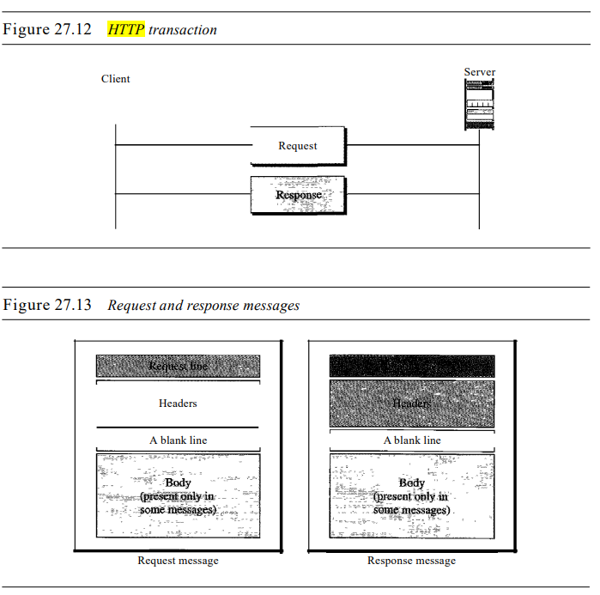

Slide 4
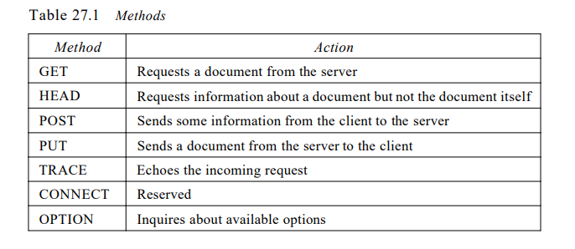

Slide 5
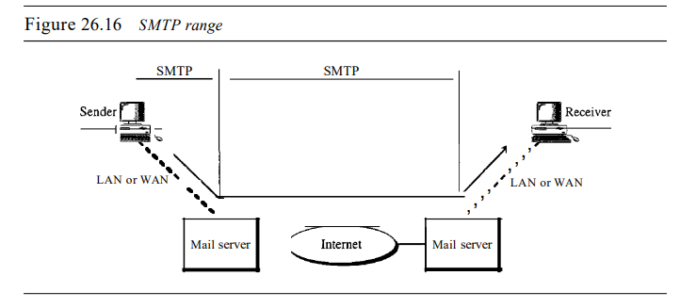
Simple Mail Transfer Protocol (SMTP)

Slide 6
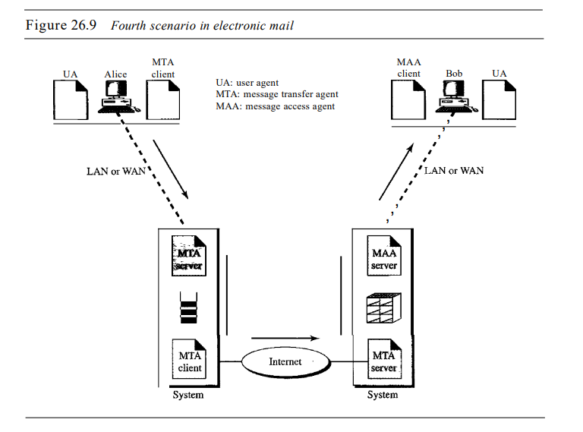

Slide 7
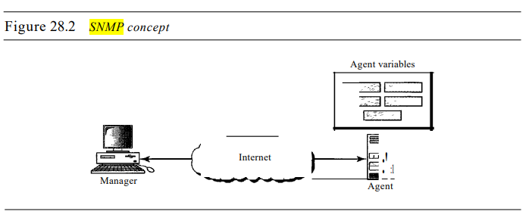
SIMPLE NETWORK MANAGEMENT PROTOCOL (SNMP)

Slide 8
SNMP uses the concept of manager and agent. That is, a manager, usually a host, controls and monitors a set of agents, usually routers.
In other words, management with SNMP is based on three basic ideas
A manager checks an agent by requesting information that reflects the behavior of the agent.
2. A manager forces an agent to perform a task by resetting values in the agent database.
3. An agent contributes to the management process by warning the manager of an unusual situation

